Slide 1





RX-CARE
HEALTH CARE APPLICATION
By Mariana Mena

Slide 2



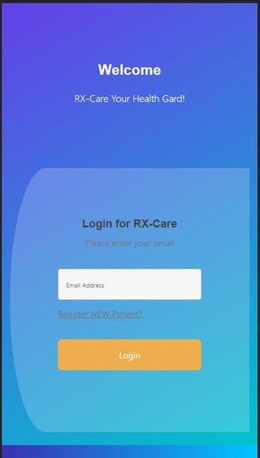
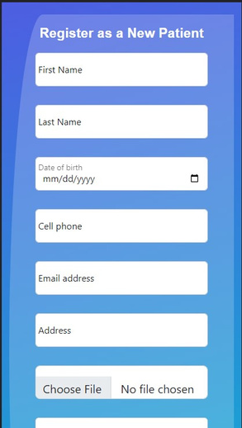
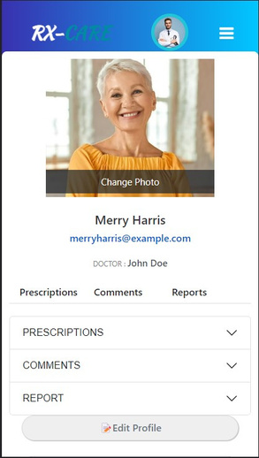

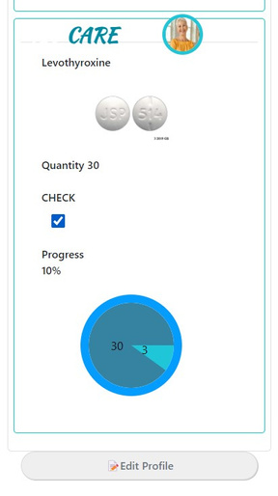
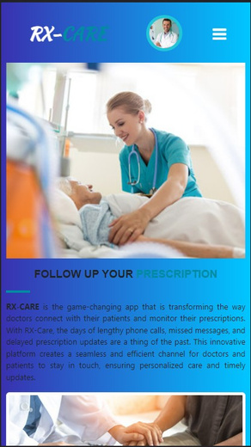
DESCRIPTION
The purpose of this application is to provide an easy and efficient platform for doctors to connect with their patients, assign new prescriptions, adjust doses, and track patients' medication intake. Patients can sign in to the app, check off when they take their medicine and communicate with their doctors seamlessly.

Slide 3


IDEA BEHIND
HYPOTHYROID
The concept of the app came from my personal experience of being diagnosed with hypothyroid. I felt the need to connect with my doctor and not feel isolated during this new chapter of my life, especially when it comes to adjusting my medication dose.

Slide 4



DEMO TIME

Slide 5














TECHNOLOGIES
FRONTEND
REACT
The frontend of the application is built using React, providing an interactive and responsive user interface.
BACKEND
C# .NET
The backend is developed using C#.NET, which powers the server-side logic and handles data processing.
DBDIAGRAM
ERD
The entity relationship diagram is built using DBDiagram
SQL
DATABASE
The application utilizes an SQL database
WIREFRME
FIGMA
The user interface is designed and framed using Figma

Slide 6

SCALABILITY AND FUTURE ENHANCEMENTS
AS A DOCTOR, I CAN:
Schedule and organize appointments, send reminders, and manage follow-ups with patients.
AS A PATIENT, I CAN:
Keep a record of my symptoms, vital signs, and daily activities to help my doctor understand my condition better.

Slide 7














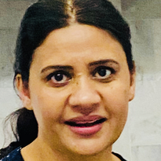










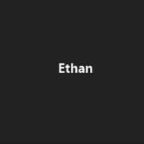





SPECIAL THANKS
FRONT-END
Lynn Samuelson
Trevor Guinn
Sydney Noh
E20
Brian Neal
Jasmine Del Casino
Derek Baylor
BACK-END

